Slide 1
Value iteration vs SARSA
A comparative analysis of both the algorithm for the Beer Pong Task

Slide 2
Objective
Implement reinforcement learning algorithm
Implement one model free algorithm and one model based algorithm (SARSA and Value Iteration)
Find the algorithm which is better for a specific no. of episodes.
Discuss the merits and demerits of each algorithm

Slide 3
Previous work done
Previously small amount of work has been done on this problem.
Dr. Osborne use this problem to implement Temporal Difference algorithm, Value Iteration and Q- learning algorithm
There he compared the performance of all the above mentioned algorithms.

Slide 4
Proposed work
Implement SARSA and Value Iteration
Portray a basic image of the actions that should be taken from any state
Discuss the merits and demerits of both algorithms
Compare the performance of both algorithm

Slide 5
Details about the model
No. of states in our Environment : 100
No. of action that can be taken : 2
Actions : 1.) Throw 2.) Change Location
Transition Probability : Given
Suitable for model based learning : Yes

Slide 6

Value Iteration Algorithm
We don’t need to do policy evaluation in each and every iteration.
Expression of updating the values are shown below:

Slide 7

SARSA
In SARSA update of current state and action is based on the next state and action.
Formula of SARSA update is shown below:

Slide 8
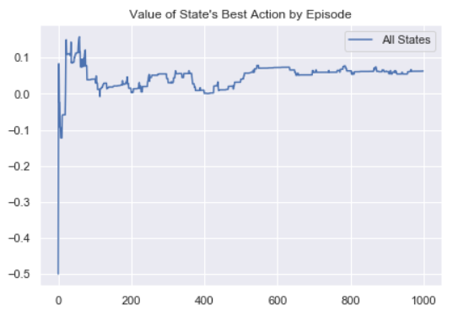
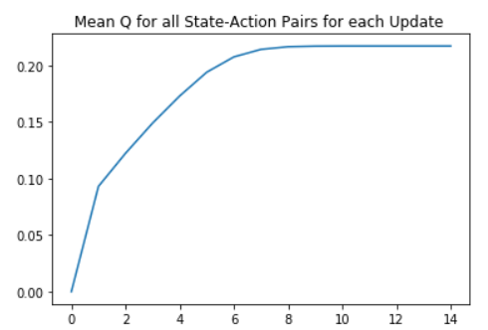
Performance Comparison
SARSA
VALUE ITERATION

Slide 9
Merit and demerits of both models
Model free learning environment and does not need complete information of each and every parameter of the environment
Updates in SARSA are just based on the next state action – value pair
SARSA
we don’t need to calculate policy evaluation during each sweep
Value Iteration

Slide 10
Conclusion
We have studied SARSA and value iteration by implementing those algorithm in a simple real world problem.
We have found out Value Iteration was giving a better result by a very small margin for this particular problem

Slide 11
THANK YOU

